Slide 1
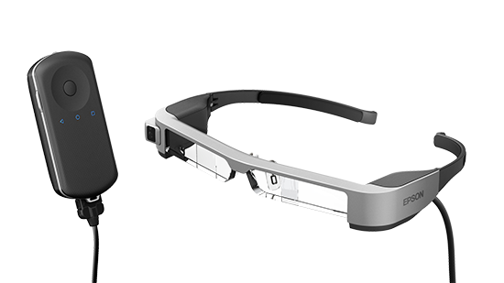
BT-300 Hurdles

Slide 2


Slide 3


Slide 4





Slide 5


Slide 6



Slide 7



Slide 8



Slide 9
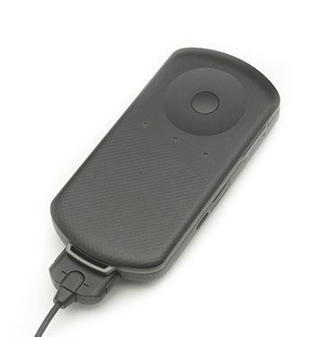

Slide 10



